Slide 1
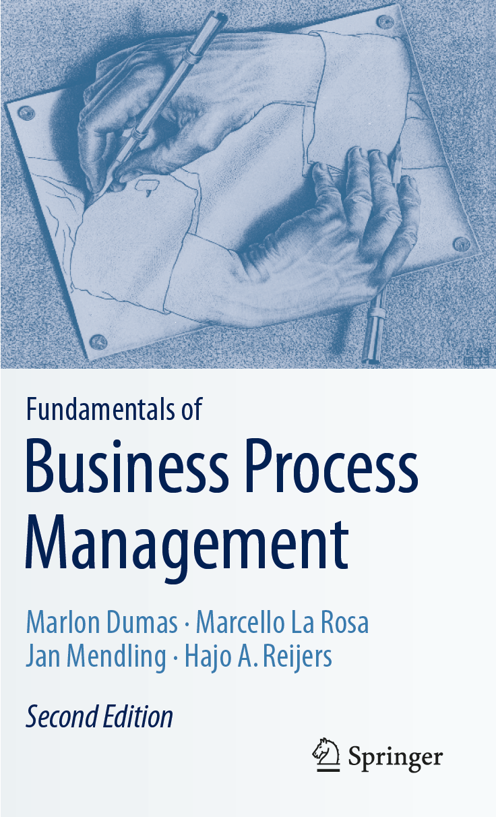
Chapter 1: Introduction to BPM
Contents
Processes Everywhere
Ingredients of a Business Process
Origins and History of BPM
  The Functional Organization
  The Birth of Process Thinking
  The Rise and Fall of BPR
The BPM Lifecycle
Recap

Slide 2
Chapter Overview
Business Process Management (BPM) is the art and science of overseeing how work is performed in an organization to ensure consistent outcomes and to take advantage of improvement opportunities.
The term “improvement” may take different meanings depending on the objectives of the organization, e.g. reducing costs, reducing execution times, and reducing error rates, but also gaining competitive advantage through innovation.
Improvement initiatives are one-off or continuous; incremental or radical.
BPM is about managing processes, i.e. entire chains of events, activities, and decisions.
In this chapter, we describe typical processes that are found in contemporary organizations.
We provide a definition of business process and BPM.
We then provide a historical overview of the BPM discipline.
Finally, we discuss the BPM lifecycle, around which the book is structured.

Slide 3
Chapter 1: Introduction to BPM
Contents
Processes Everywhere
Ingredients of a Business Process
Origins and History of BPM
  The Functional Organization
  The Birth of Process Thinking
  The Rise and Fall of BPR
The BPM Lifecycle
Recap

Slide 4
Examples of Processes in Many Organizations
Order-to-Cash
Quote-to-Order
Procure-to-Pay
Issue-to-Resolution
Application-to-Approval

Slide 5
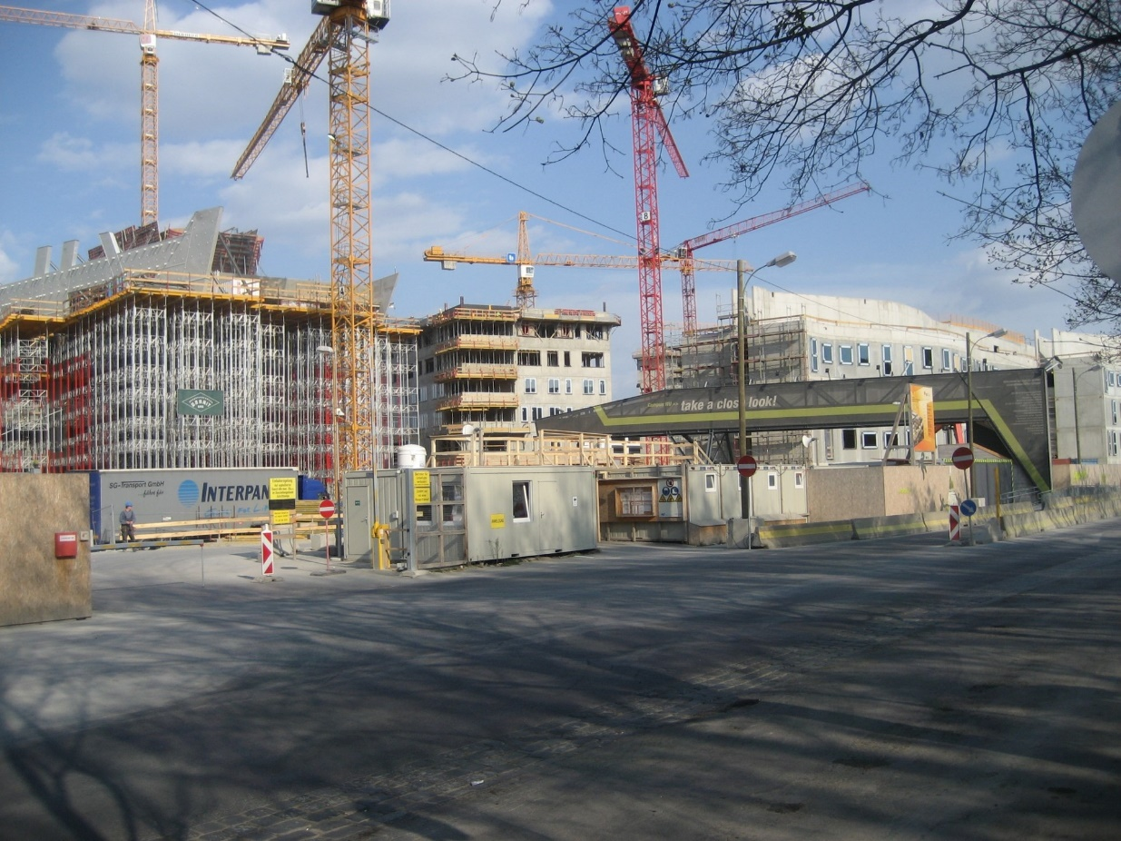
Example: Construction Company BuildIT
Construction Site of WU Vienna‘s New Campus opened in 2013.
Source: Wikimedia Commons

Slide 6
Equipment Rental Process at BuildIT
BuildIT is a construction company specialized in public works, such as roads, bridges, pipelines, tunnels and railroads. Within BuildIT, it often happens that engineers working at a construction site (called site engineers) need a piece of equipment, such as a truck, an excavator, a bulldozer, a water pump, etc. BuildIT owns very little equipment and instead it rents most of its equipment from specialized suppliers.
The existing business process for renting equipment goes as follows. When site engineers need to rent a piece of equipment, they fill in a form called “Equipment Rental Request” and send this request by email to one of the clerks at the company’s depot. The clerk at the depot receives the request and, after consulting the catalogs of the equipment suppliers, selects the most cost-effective equipment that complies with the request. Next, the clerk checks the availability of the selected equipment with the supplier via phone or email. Sometimes the selected option is not available. In these cases, the clerk has to select an alternative piece of equipment and check its availability with the corresponding supplier.
After finding a suitable and available piece of equipment, the clerk adds the details of the selected equipment to the rental request. Each rental request has to be approved by a works engineer, who also works at the depot. In some cases, the works engineer rejects the equipment rental request. Some rejections lead to the cancelation of the request, i.e., no equipment is rented at all. Other rejections are resolved by replacing the selected equipment with another equipment – such as a cheaper piece of equipment or a more appropriate piece of equipment for the job. In this latter case, the clerk needs to lodge another availability request.

Slide 7
Equipment Rental Process at BuildIT
When a works engineer approves a rental request, the clerk sends a confirmation to the supplier. This confirmation includes a Purchase Order (PO) for renting the equipment. The PO is produced by BuildIT’s financial information system using information entered by the clerk. The clerk also records the equipment rental in a spreadsheet that is used to monitor rentals.
In the meantime, the site engineer may decide that the equipment is no longer needed. In this case, the engineer asks the clerk to cancel the request for renting the equipment.
In due time, the supplier delivers the rented equipment to the construction site. The site engineer then inspects the equipment. If everything is in order, the site engineer accepts the engagement and the equipment is put into use. In some cases, the equipment is sent back because it does not comply with the requirements of the site engineer. In this case, the site engineer has to start the rental process all over again.
When the rental period expires, the supplier comes to pick up the equipment. Sometimes, the site engineer asks for an extension of the rental period by contacting the supplier via email or phone one to two days before pick-up. The supplier may accept or reject this request.
A few days after the equipment is picked up, the supplier sends an invoice to the clerk by email. At this point, the clerk asks the site engineer to confirm that the equipment was indeed rented for the period indicated in the invoice. The clerk also checks if the rental prices indicated in the invoice are in accordance with those in the PO. After these checks, the clerk forwards the invoice to the financial department. The financial department eventually pays the invoice.

Slide 8
Chapter 1: Introduction to BPM
Contents
Processes Everywhere
Ingredients of a Business Process
Origins and History of BPM
  The Functional Organization
  The Birth of Process Thinking
  The Rise and Fall of BPR
The BPM Lifecycle
Recap

Slide 9
Definition of Business Process
A business process as a collection of inter-related events, activities, and decision points that involve a number of actors and objects, which collectively lead to an outcome that is of value to at least one customer.

Slide 10
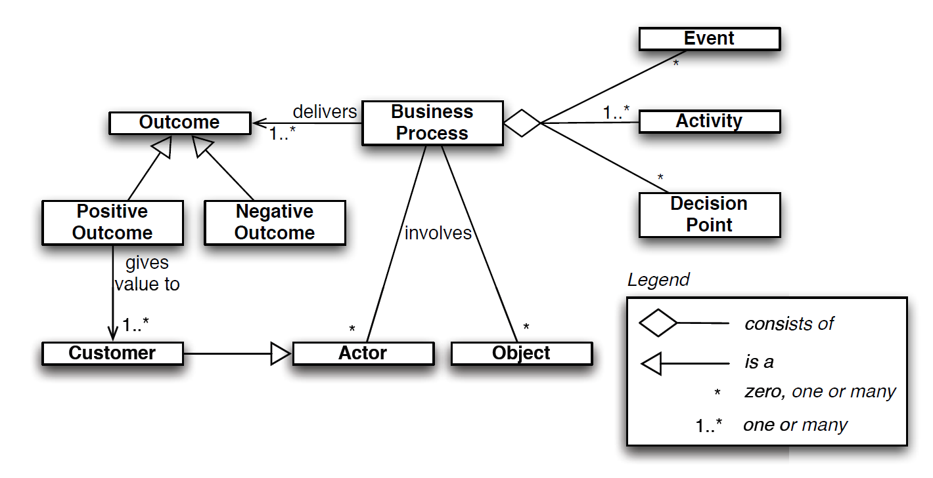
Ingredients of a Business Process

Slide 11
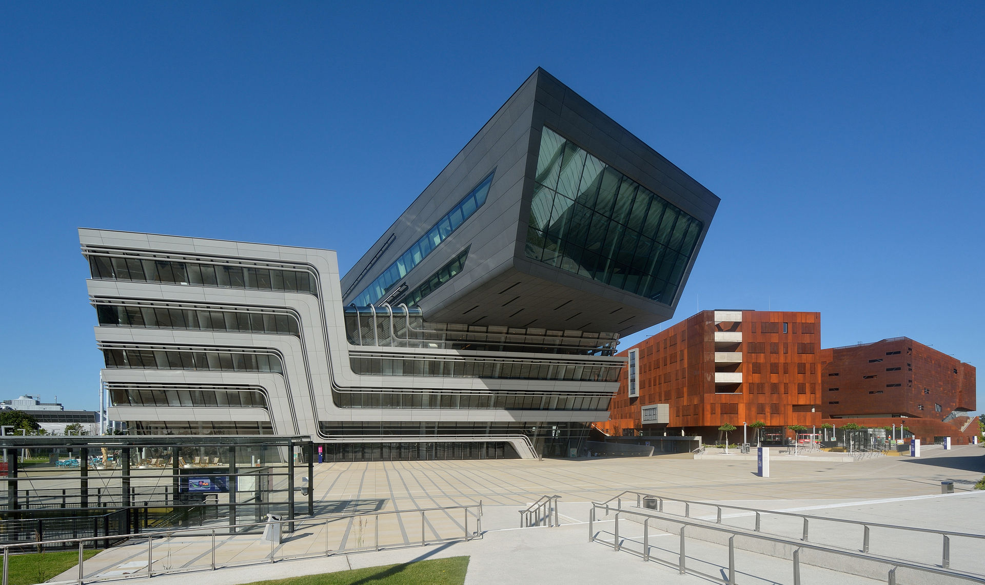
Exercise 1.1: University Admission Process
WU Vienna‘s New Campus opened in 2013. Source: Wikimedia Commons

Slide 12
Exercise 1.1: University Admission Process
Consider the process for the admission of international graduate students at a university.
In order to apply for admission, students first fill in an online form. Online applications are recorded in an information system to which all staff members involved in the admissions process have access. After a student has submitted the online form, a PDF document is generated and the student is requested to download it, sign it, and send it by post together with the required documents, which include:
  certified copies of previous degree and academic transcripts,
  results of English language test,
  curriculum vitae,
  two reference letters.

Slide 13
Exercise 1.1: University Admission Process
When these documents are received by the admissions office, an officer checks the completeness of the documents. If any document is missing, an email is sent to the student. The student has to send the missing documents by post. Assuming the application is complete, the admissions office sends the certified copies of the degrees to an academic recognition agency, which checks the degrees and gives an assessment of their validity and equivalence in terms of local education standards. This agency requires that all documents be sent to it by post, and that all documents be certified copies of the originals. The agency sends back its assessment to the university by post as well. Assuming the degree verification is successful, the English language test results are then checked online by an officer at the admissions office. If the validity of the English language test results cannot be verified, the application is rejected (such notifications of rejection are sent by email).

Slide 14
Exercise 1.1: University Admission Process
Once all documents of a given student have been validated, the admissions office forwards these documents by internal mail to the corresponding academic committee responsible for deciding whether to offer admission or not. The committee makes its decision based on the academic degrees and transcripts, the CV, and the reference letters. The committee meets once every three months to examine all applications that are ready for academic assessment at the time of the meeting.
At the end of the committee meeting, the chair of the committee notifies the admissions office of the selection outcomes. This notification includes a list of admitted and rejected candidates. A few days later, the admissions office notifies the outcome to each candidate via email. Additionally, successful candidates are sent a confirmation letter by post.
With respect to the above process, consider the following questions:
  Who are the actors in this process?
  Which actors can be considered as customers in this process?
  What value does the process deliver to its customers?
  What are the possible outcomes of this process?

Slide 15
Definition of Business Process Management
BPM as a body of methods, techniques, and tools to identify, discover, analyze, redesign, execute, and monitor business processes in order to optimize their performance.

Slide 16
Related Disciplines
Total Quality Management (TQM)
  Focus on continuously improving and sustaining the quality of products and services.
  TQM puts emphasis on products and services themselves, while BPM focuses on improvement of processes.
  Applications of TQM are primarily in manufacturing while BPM more in service organizations.
Operations Management
  Concerned with managing physical and technical functions of organization, particularly those relating to production and manufacturing.
  Using probability theory, queuing theory, decision analysis, mathematical modeling, and simulation for optimizing efficiency of operations.
  Such techniques are also useful in.
  Often concerned with controlling an existing process, while BPM making changes to an existing process in order to improve it.

Slide 17
Related Disciplines
Lean
  Originates from manufacturing, in particular Toyota Production System.
  Eliminates waste, i.e., activities that do not add value to the customer.
  BPM puts more emphasis on use of information technology as a tool to improve business processes and to make them more consistent and repeatable.
Six Sigma
  Originates from manufacturing, in particular from production practices at Motorola.
  Focuses on minimization of defects (errors).
  Strong emphasis on measuring output of processes, especially in terms of quality.
  Popular approach to blend Lean with Six Sigma, leading to Lean Six Sigma.

Slide 18
Chapter 1: Introduction to BPM
Contents
Processes Everywhere
Ingredients of a Business Process
Origins and History of BPM
  The Functional Organization
  The Birth of Process Thinking
  The Rise and Fall of BPR
The BPM Lifecycle
Recap

Slide 19
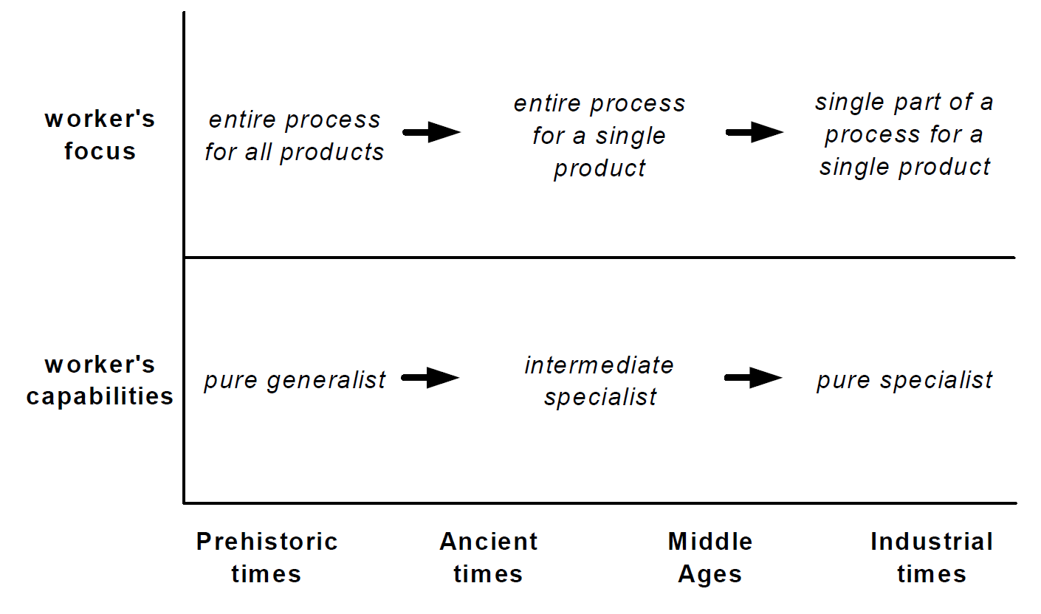
How process moved out of focus through ages

Slide 20
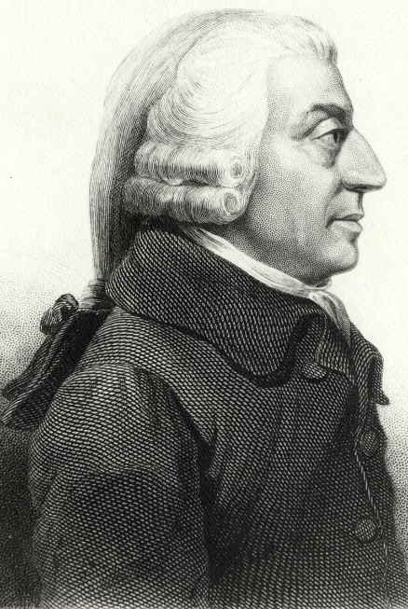
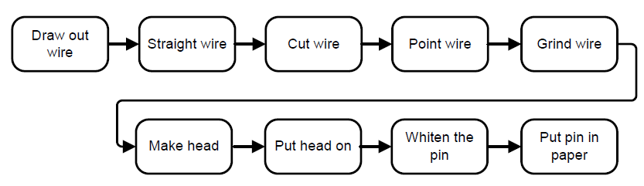
Adam Smith: Processes and Division of Labour
“To take an example, the trade of a pin-maker: But in the way in which this
business is now carried on, it is divided into a number of branches:
One man draws out the wire; another straights it;
a third cuts it; a fourth points it; a fifth grinds it at the
top for receiving the head; to make the head requires
three operations; to put it on is a peculiar business;
to whiten the pins is another; to put them into the paper;
and the important business of making a pin is, in this
manner, divided into about eighteen distinct operations.”
Source: Smith 1776
Picture: http://www.library.hbs.edu/hc/collections/kress/kress_img/adam_smith2.htm

Slide 21
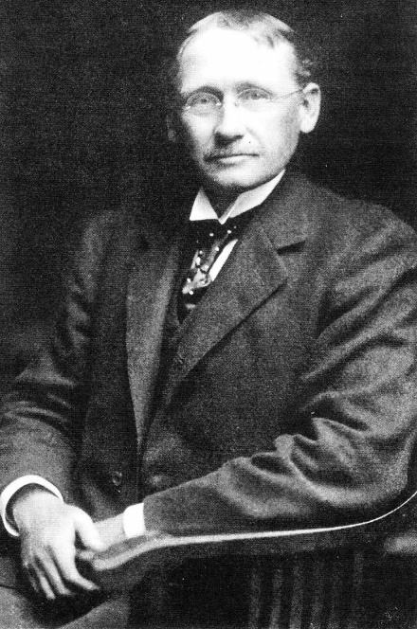
Frederick W. Taylor: Scientific Management
Meticulously studying labor activities
Work instructions for workers
Managers oversee the productivity of groups of workers
Units and their managers were structured hierarchically
Functional organization remains dominant until the end of 1980s.
Source: Wikimedia Commons

Slide 22
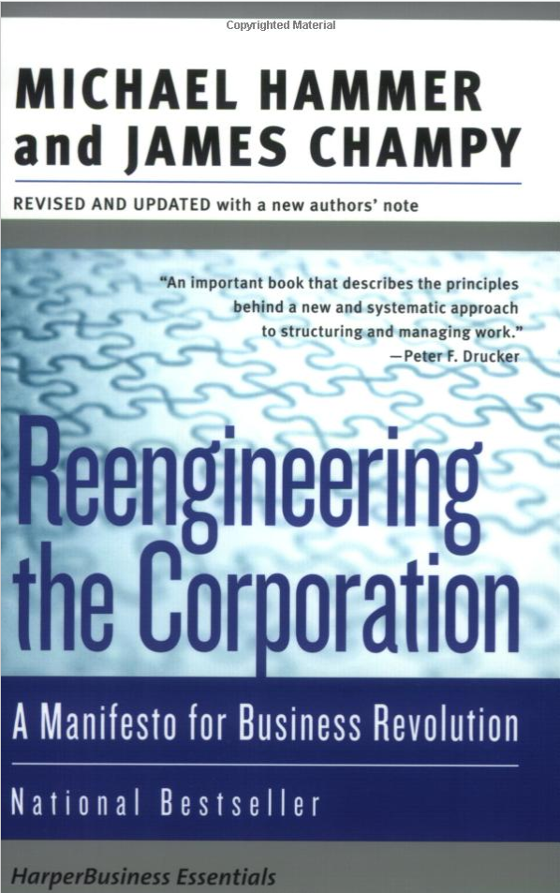
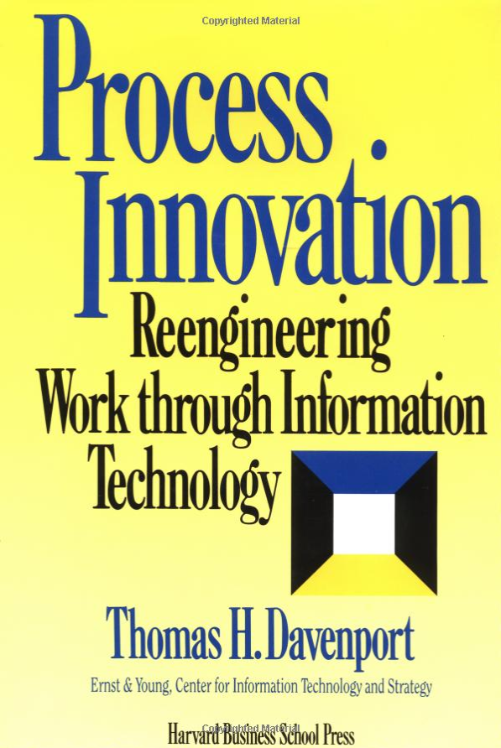
Birth of Process Thinking:
Business Process Reengineering (BPR)

Slide 23
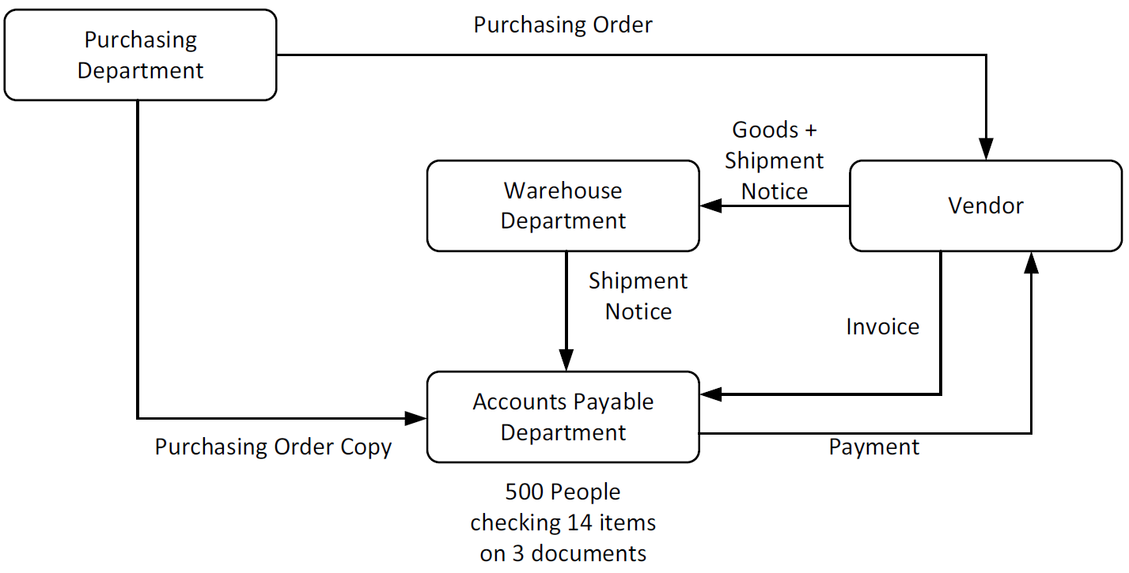
Purchasing process at Ford at the initial stage

Slide 24
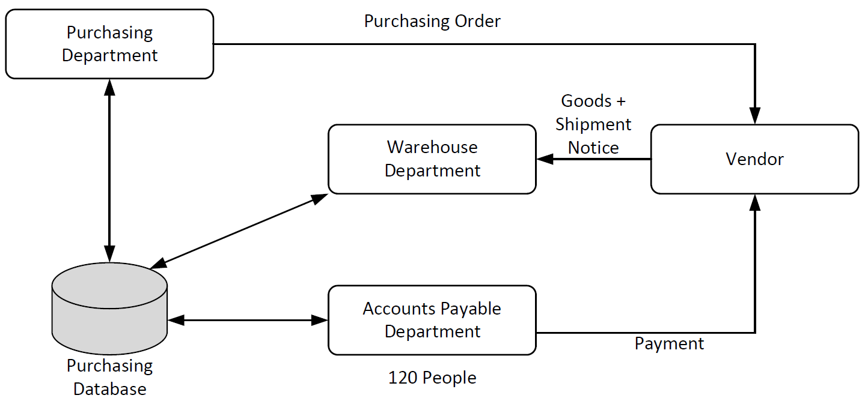
Purchasing process at Ford after redesign

Slide 25
Exercise 1.2: Purchasing process at Ford
Consider the purchasing process at Ford.
Who are the actors in this process?
Which actors can be considered as customers in this process?
What value does the process deliver to its customers?
What are the possible outcomes of this process?

Slide 26
The Rise and Fall of BPR
Concept misuse:
  Projects were labeled BPR, even when business processes were not the core.
  Many corporations initiated reductions of workforce, often packaged as process redesign projects, which triggered resentment.
Over-radicalism:
  Hammer’s early papers states: “Don’t Automate, Obliterate”.
  Many situations require a much more gradual (incremental) approach.
Support immaturity:
  Necessary tools and technologies were not yet available or insufficient.
  Much process logic had to be hard-coded in IT applications of the time.
  People grew frustrated when they noted that their efforts on redesigning a process were thwarted by a rigid infrastructure.

Slide 27
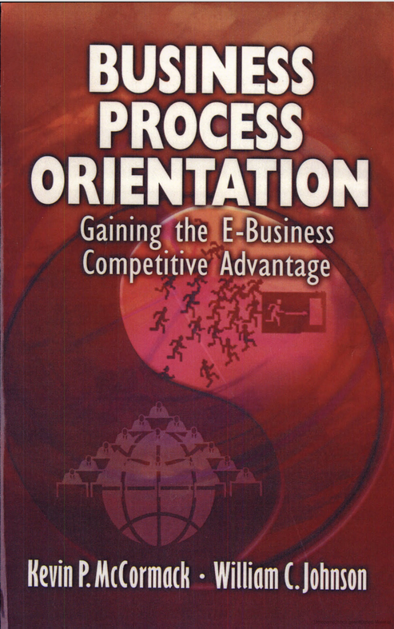
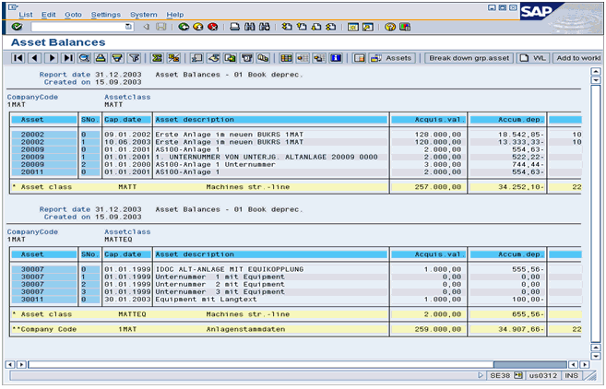
Reshaping Process Thinking
Process Orientation is productive
ERP Systems penetrate the market

Slide 28
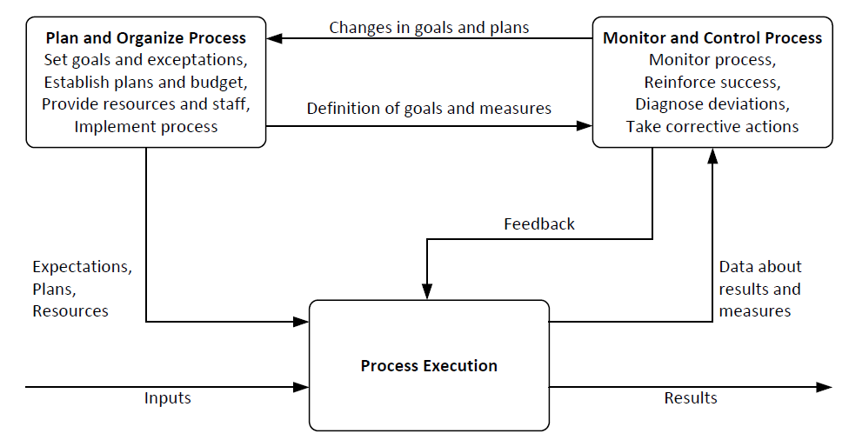
Job Functions of Process Owner

Slide 29
Chapter 1: Introduction to BPM
Contents
Processes Everywhere
Ingredients of a Business Process
Origins and History of BPM
  The Functional Organization
  The Birth of Process Thinking
  The Rise and Fall of BPR
The BPM Lifecycle
Recap

Slide 30
Establishing Process Thinking in Organizations
Establish BPM Team
Describe Process Architecture
Define Process Performance Measures
Discover and Model Processes
Analyze, Redesign, Implement and Monitor Processes
Make Use of Process-Aware Information Systems

Slide 31
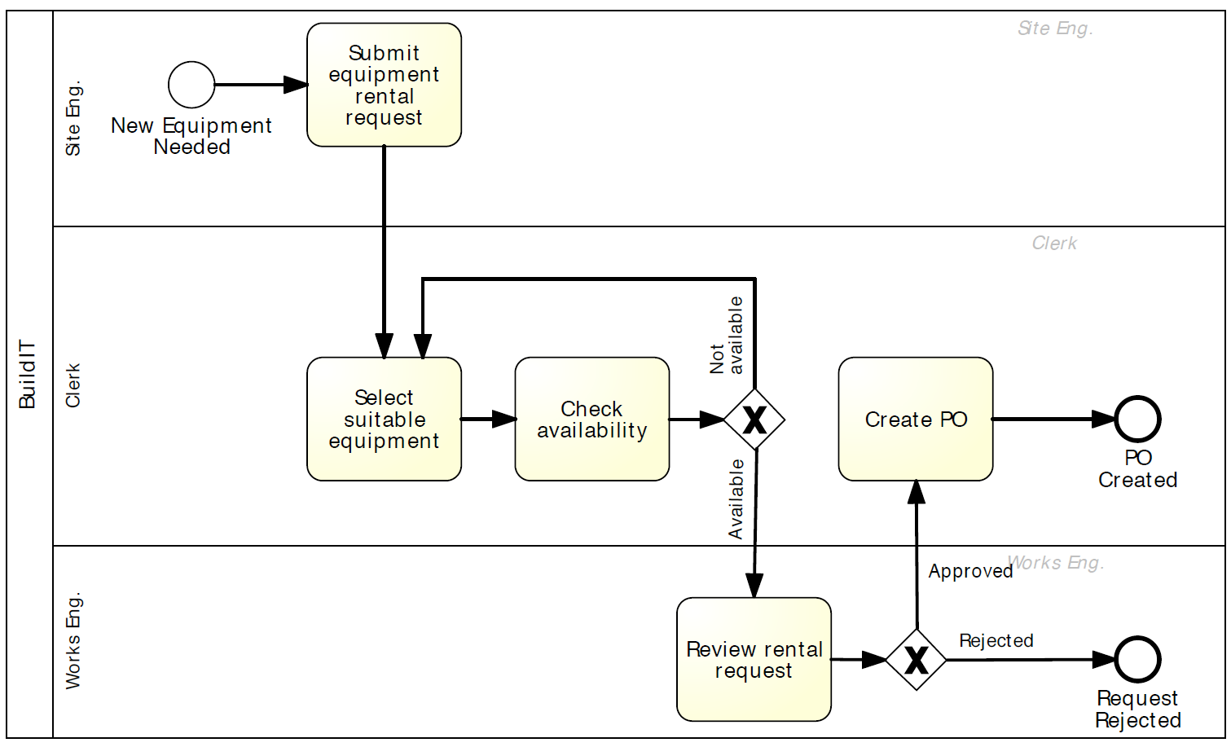
Example: Process model for the initial fragment of the equipment rental process

Slide 32
Exercises 1.3-5: University Admission Process
WU Vienna‘s New Campus opened in 2013. Source: Wikimedia Commons

Slide 33
Exercises 1.3-5: University Admission Process
Consider the student admission process described in Exercise 1.1 (page 5).
Exercise 1.3: Taking the perspective of the customer, identify at least two performance measures that can be attached to this process.
Exercise 1.4: Taking the perspective of the customer, think of at least two issues that this process might have.
Exercise 1.5: What possible changes do you think could be made to this process in order to address these issues?

Slide 34
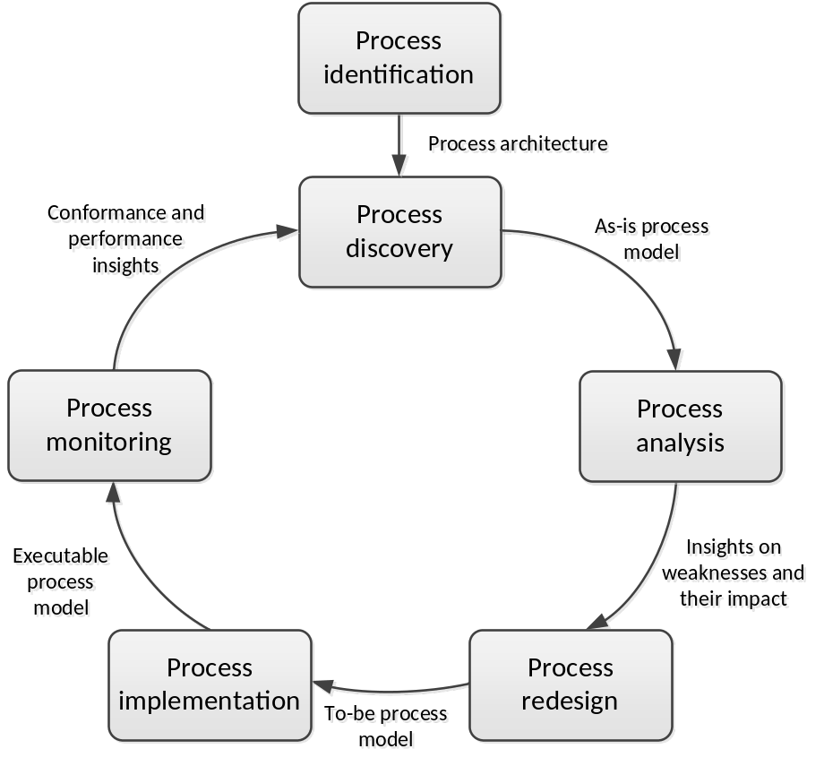
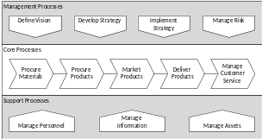
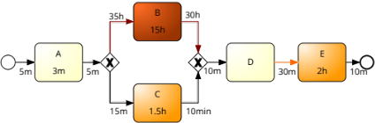

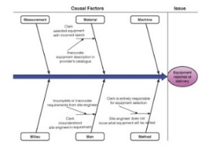
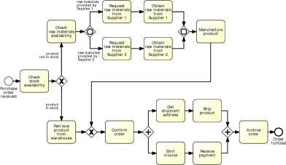

The BPM Lifecycle

Slide 35
Stakeholders in the BPM Lifecycle
Management Team:
  Chief Executive Officer (CEO) responsible for overall business success.
  Chief Operations Officer (COO) responsible for defining the way operations are set up, sometimes Chief Process Officer (CPO) or Chief Process and Innovation Officer (CPIO).
  Chief Information Officer (CIO) responsible for operation of information system infrastructure.
  Chief Financial Officer (CFO) responsible for overall financial performance of the company.
  Human Resources (HR) director plays key role in processes that involve many process participants.
Process Owners:
  Process owner is responsible for efficient and effective operation of a given process, including
  Planning and organizing, i.e. defining performance measures and objectives as well as initiating and leading improvement projects.
  Monitoring, i.e. ensuring that performance objectives are met, and taking corrective actions.
  Process owner is involved in process modeling, analysis, redesign, implementation, and monitoring.

Slide 36
Stakeholders in the BPM Lifecycle
Process Participants:
  Perform activities of business process on day-to-day basis.
  Conduct routine work according to the standards and guidelines of the company.
  Coordinated by process owner, who is responsible for non-routine aspects of process.
  Involved as domain experts during process discovery and process analysis.
  Support redesign activities and implementation.
Process Analysts:
  Conduct process identification, discovery, analysis, and redesign.
  Coordinate implementation and monitoring.
  Report to management and process owners
  Have business or IT background.
Process Methodologist:
  Provides advice on methods, techniques and software tools.
  Coordinates technical training.
System Engineers:
  Translate requirements into system design
  Responsible for implementation, testing and deployment.
BPM Group (also BPM Center of Excellence):
  Responsible for preserving project knowledge and documentation.
  Maintain process architecture.
  Prioritize process redesign projects.
  Align the BPM efforts with strategic goals.
  Most common in large organizations with several years of BPM experience.

Slide 37
Chapter 1: Introduction to BPM
Contents
Processes Everywhere
Ingredients of a Business Process
Origins and History of BPM
  The Functional Organization
  The Birth of Process Thinking
  The Rise and Fall of BPR
  The BPM Lifecycle
Recap

Slide 38
Recap
A process is a collection of events, activities, and decisions that collectively lead to an outcome that brings value to an organization’s customers.
Every organization has processes.
Managing processes ensures that they produce value.
BPM is a body of principles, methods, and tools to design, analyze, execute, and monitor business processes.
Process models and performance measures are pillars for managing processes.
Various related disciplines complement BPM, such as Lean, Six Sigma, and Total Quality Management.

